Slide 1
MENTOS: A Statistical Thermodynamic Approach for Modeling Metabolism
Jeremy Zucker, Neeraj Kumar, and William Cannon
Computational Biology and Bioinformatics Group,
Pacific Northwest National Laboratory

Slide 2
Measuring absolute metabolite concentrations is hard
No single analytical tool can measure all metabolites due to diverse physical properties of small molecules
Relative concentrations much easier to measure than Absolute concentrations
Absolute concentrations can be measured by comparing isotopically labeled standards to unlabeled metabolite
Also possible to compare isotopically labeled metabolite to unlabeled standard.

Slide 3
Predicting absolute metabolite concentrations is hard
Constraint-based methods such as flux balance analysis (FBA) have been successfully used to predict the steady-state metabolic fluxes that maximize the growth rate, but net flux predictions by themselves provide no information about the metabolite concentrations.
Kinetic models can be used to predict metabolite concentrations and fluxes at steady-state, but cannot generally be applied at the genome scale due to the experimental intractability of measuring rate constants in a high-throughput manner
Genome-scale thermodynamic-based methods have been developed that constrain the reaction direction of metabolic fluxes using measured metabolite concentrations. More recently, a thermodynamic method has been developed that can predict metabolite concentrations by hypothesizing that a metabolic "tug of war" exists between osmotic pressure that tends to drive metabolite concentrations down and the cost associated with enzyme production that drives up ratios of reactant-to-product concentrations.

Slide 4
Metabolite concentrations have the strongest physiological effect on net fluxes, not enzymes

Slide 5
Alternative approach to modeling metabolism
Use the law of mass action to develop thermokinetic models that can predict non-steady-state dynamics in the absence of rate constants
Maximize entropy production to find a steady state that is both kinetically and thermodynamically optimal
Test the (null) hypothesis that what drives metabolite concentrations and fluxes in natural systems is an evolutionary pressure to extract energy from the environment as quickly and efficiently as possible.

Slide 6
Use the law of mass action to develop thermokinetic models that can predict non-steady-state dynamics in the absence of rate constants

Slide 7
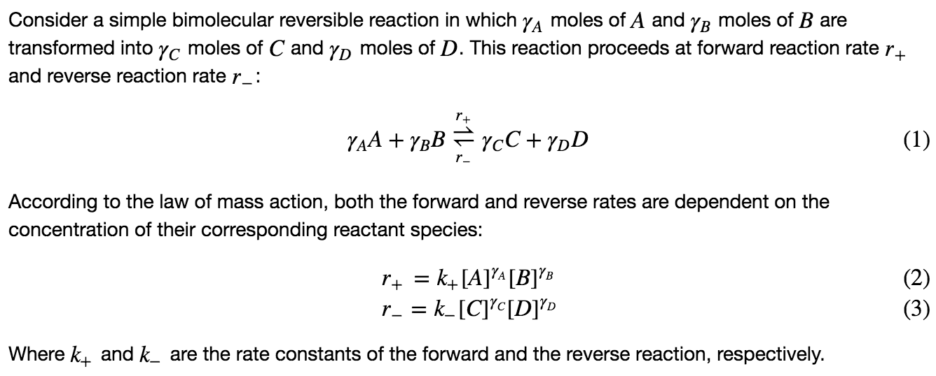
The law of mass action implies every reaction has two unknown rate constants.

Slide 8
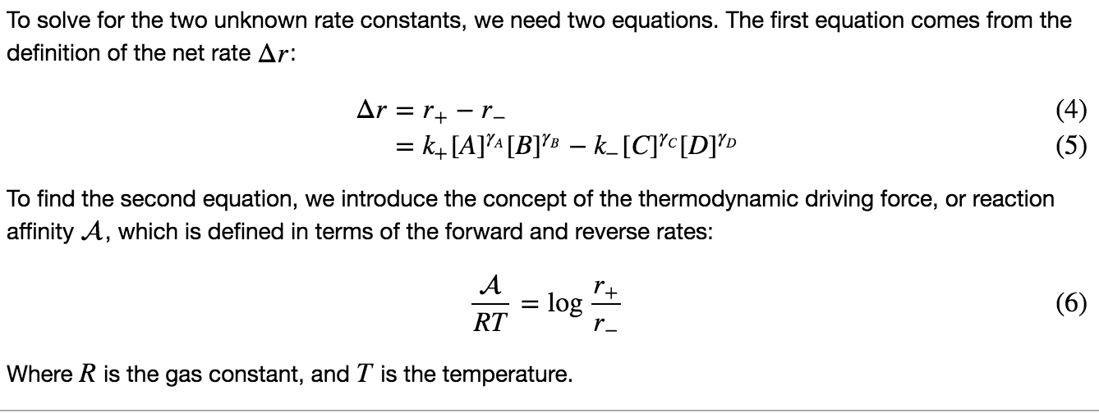
Solving for the rate constants using net rate and the thermodynamic force

Slide 9
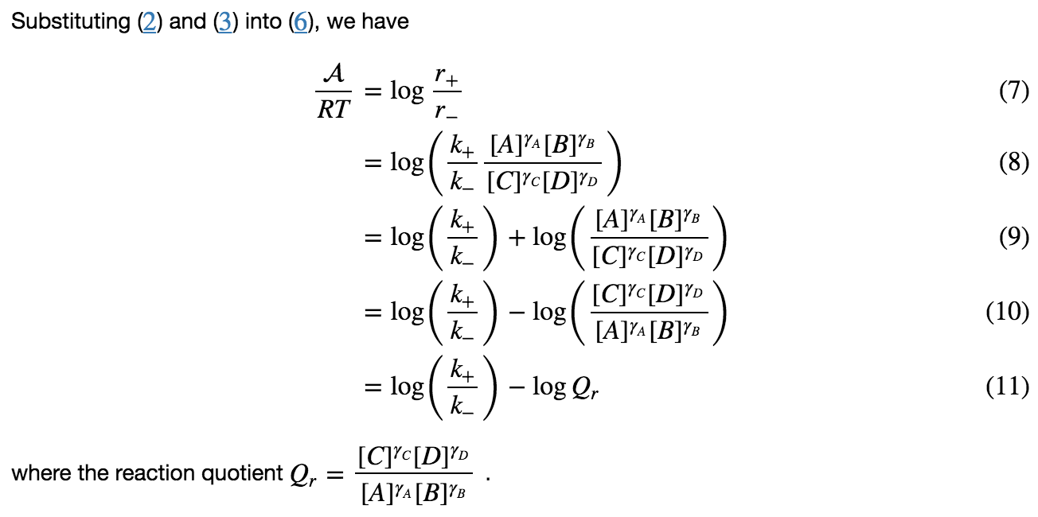
Solving for the rate constants using net rate and the thermodynamic force

Slide 10
Gibbs free energy is the thermodynamic force applied over the extent of a reaction

Slide 11
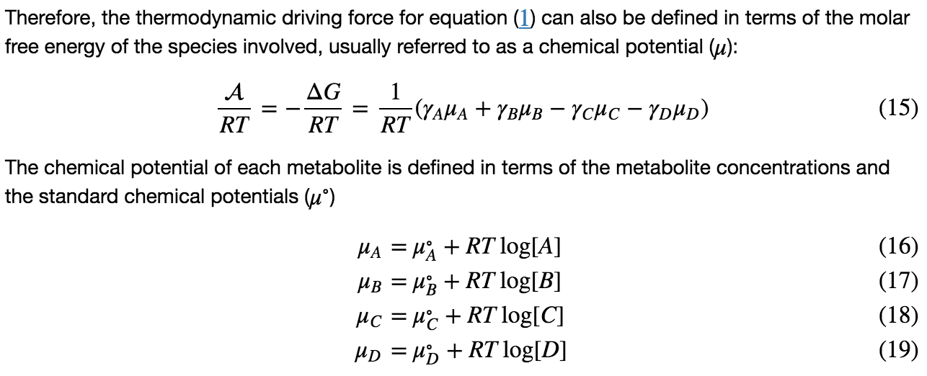
Solving for the rate constants using chemical potentials and the thermodynamic force

Slide 12
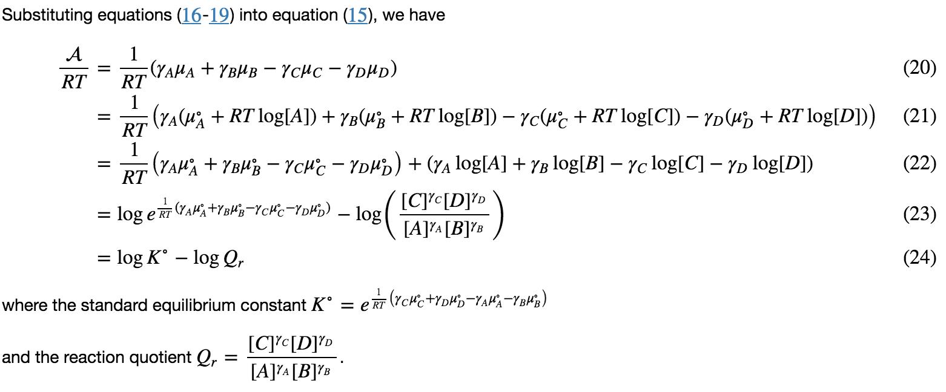
Solving for the rate constants using chemical potentials and the thermodynamic force

Slide 13
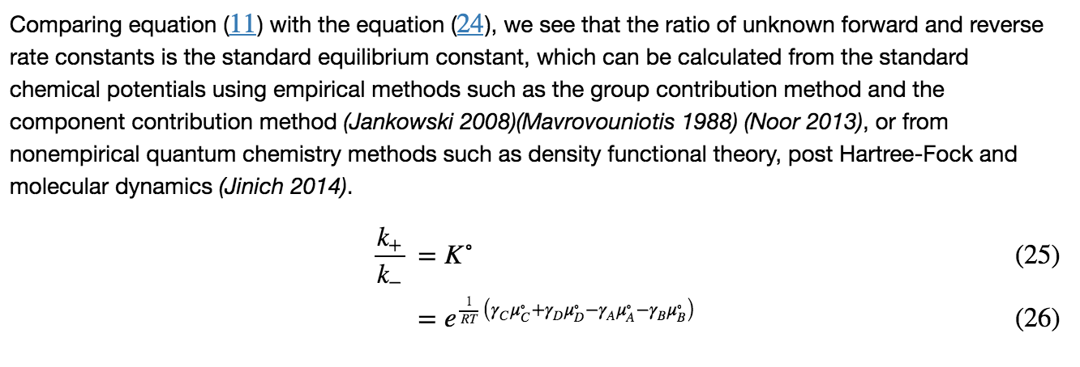
The ratio of the unknown rate constants is equal to the known equilibrium constant

Slide 14
Rate constants can be obtained from the concentrations and the net flux at steady state

Slide 15
Maximize entropy production to find a steady state that is both kinetically and thermodynamically optimal

Slide 16
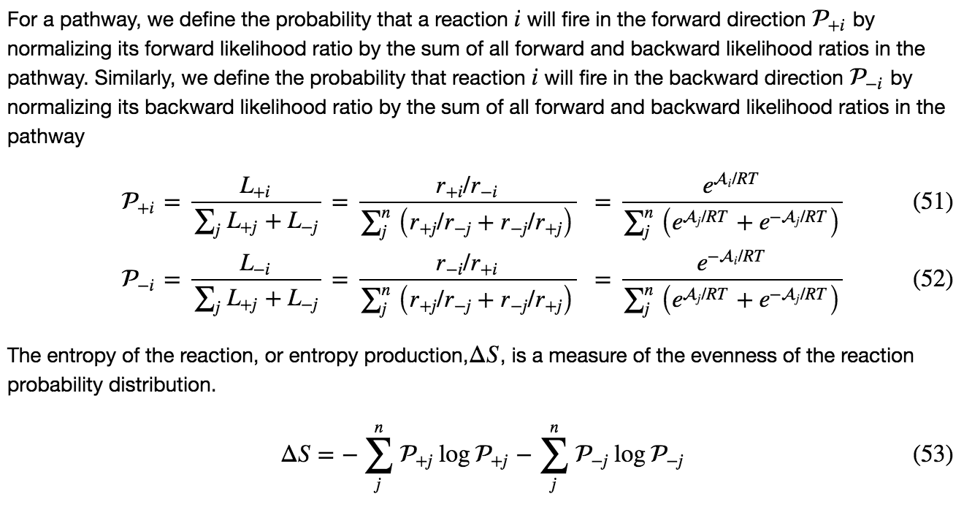
Entropy production measures how evenly the thermodynamic force is distributed.

Slide 17
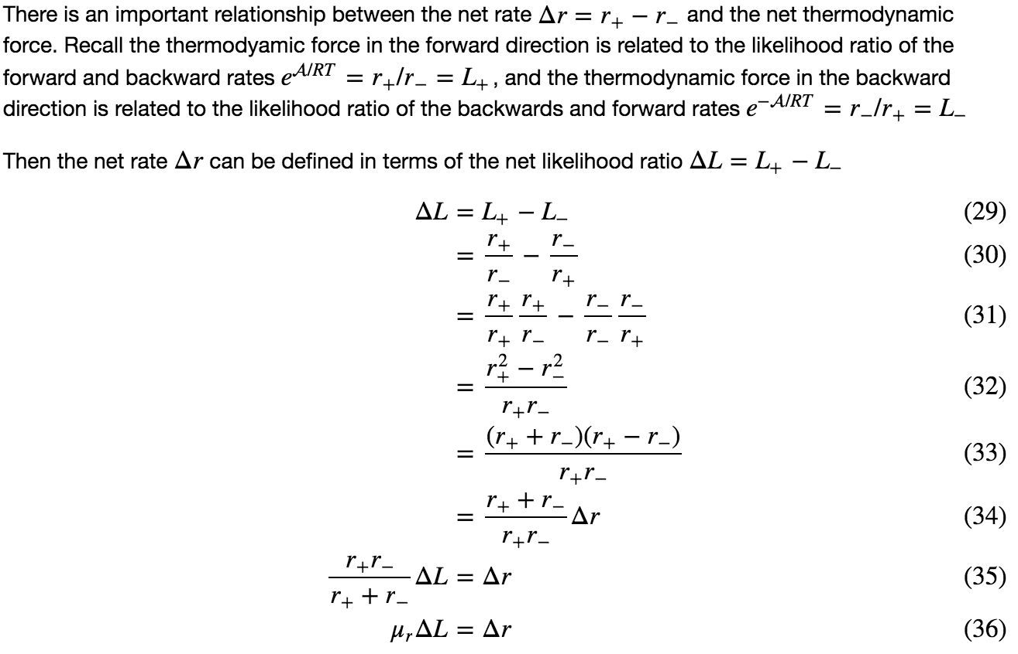
Net fluxes are proportional to the net thermodynamic force

Slide 18
Nonconvex MENTOS solves for forward and reverse likelihoods and log concentrations simultaneously

Slide 19
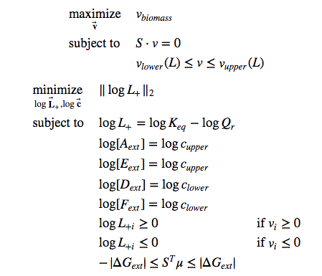
Convex MENTOS solves for net fluxes and likelihoods sequentially

Slide 20
Applying MENTOS to the ABC model

Slide 21
Applying MENTOS to the ABC model

Slide 22
Even distribution of energy across first elementary mode

Slide 23
Even distribution of energy across second elementary mode

Slide 24
Even distribution of energy across both elementary modes

Slide 25
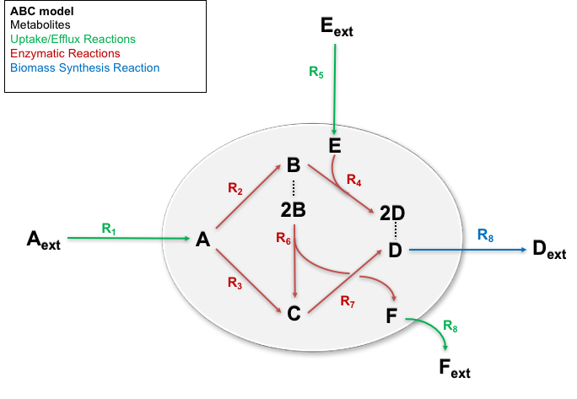
Applying MENTOS to the ABC model

Slide 26
Elementary modes of the ABC model

Slide 27
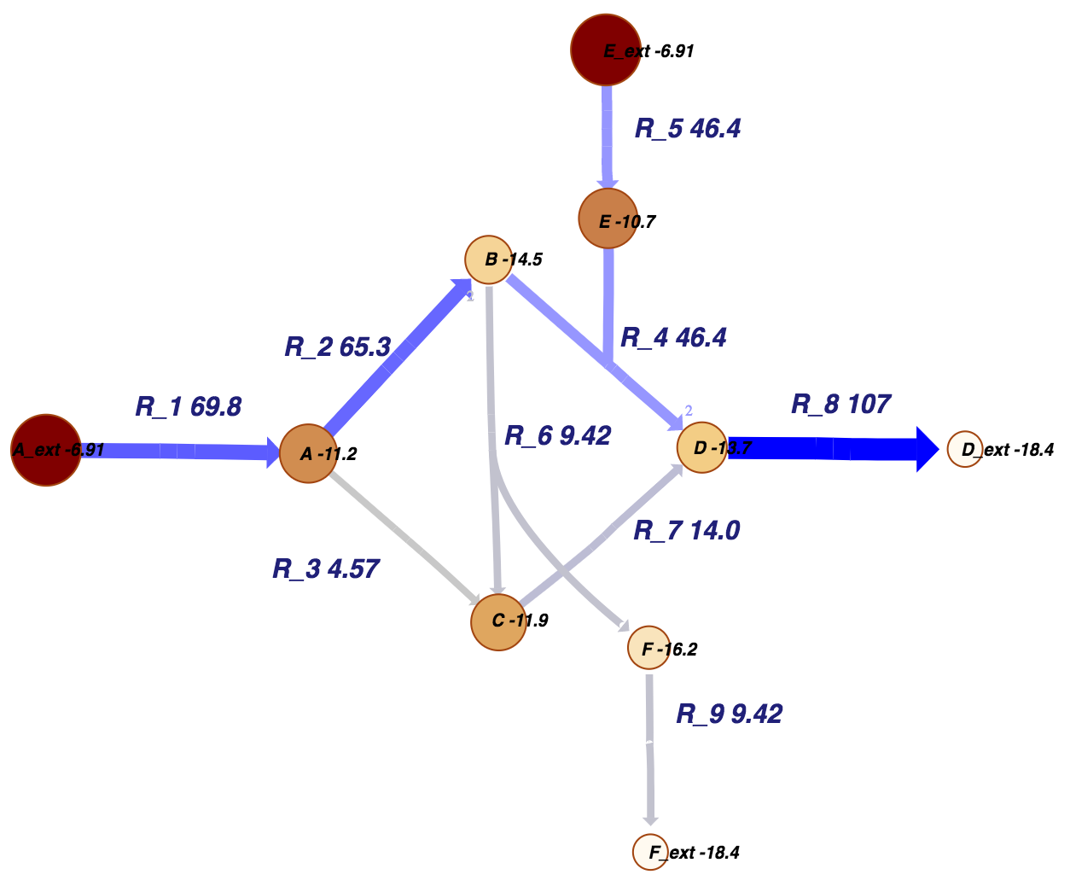
Material view: Log concentrations and fluxes
Notes:
MENTOS prediction of the net difference between the likelihood ratio of forward to backward rates and the likelihood ratio of backward to forward rates (edges) and log concentrations (nodes). Net likelihoods satisfy the steady-state constraint, and are proportional to the fluxes that are predicted to be associated with these metabolite concentrations

Slide 28
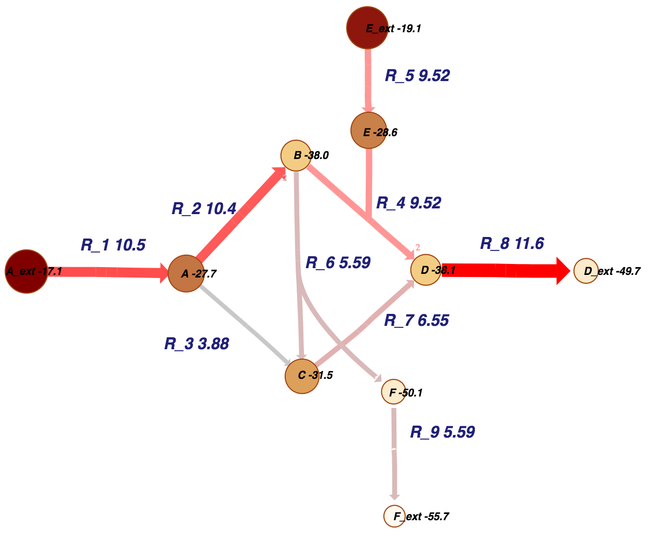
Energy view: Chemical potentials and thermodynamic force
Notes:
MENTOS prediction of the thermodynamic force (edges) and chemical potential (nodes). The thermodynamic force is the difference between reactant and product chemical potentials, weighted by their respective stoichiometries, and is equal to the negative change in gibbs free energy of the reaction.

Slide 29
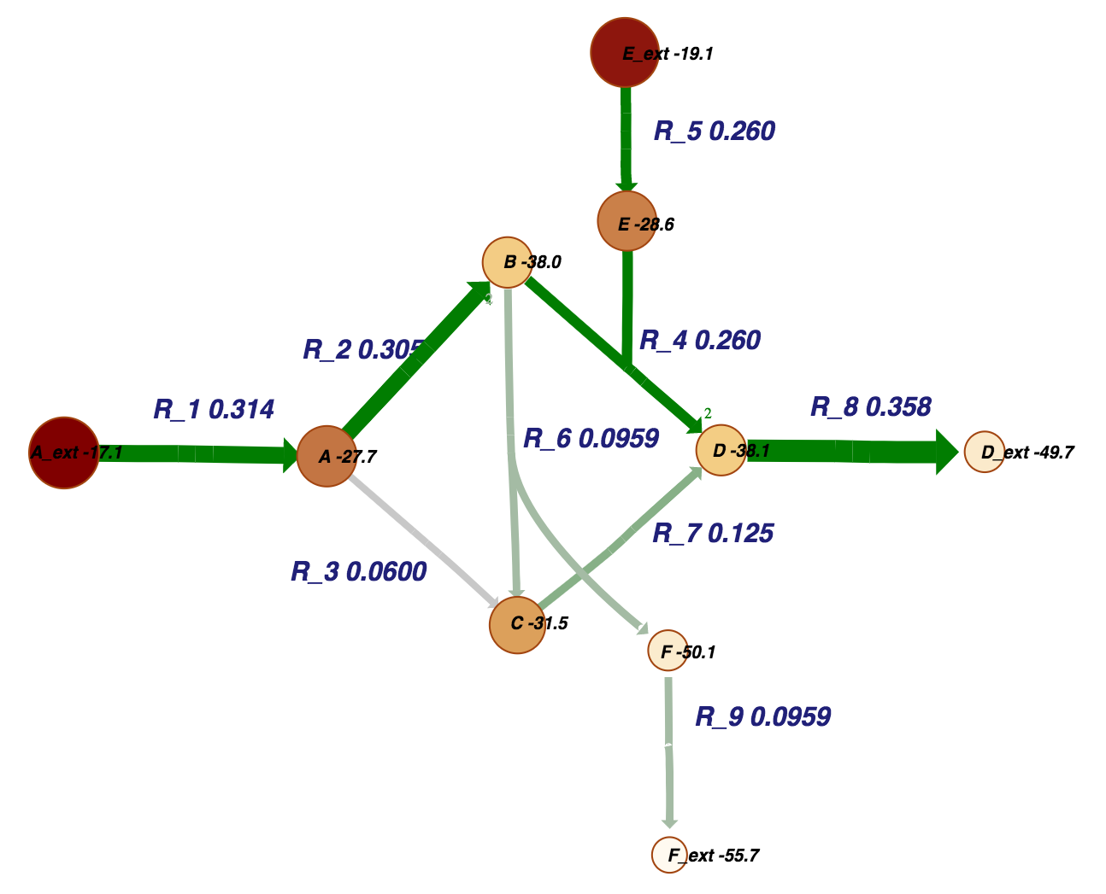
Entropy production view: Chemical potentials and thermodynamic force
Notes:
MENTOS prediction of the reaction entropy (edges) and chemical potential (nodes) The reaction entropy is the entropy of the normalized~ likelihood ratios.

Slide 30
Testing the hypothesis with measured rates and concentrations from E. coli Park, J. O., Rubin, S. A., Xu, Y.-F., Amador-Noguez, D., Fan, J., Shlomi, T., & Rabinowitz, J. D. (2016). Metabolite concentrations, fluxes and free energies imply efficient enzyme usage. Nature Chemical Biology, advance on(7), 482–489. https://doi.org/10.1038/nchembio.2077

Slide 31
Material view: Log concentrations and fluxes

Slide 32
Energy view: Chemical potentials and Delta G are not evenly distributed

Slide 33
Take home message
Used the law of mass action to develop thermokinetic models that can predict non-steady-state dynamics in the absence of rate constants
Maximized entropy production to find a steady state that is both kinetically and thermodynamically optimal
Proposed the (null) hypothesis that what drives metabolite concentrations and fluxes in natural systems is an evolutionary pressure to extract energy from the environment as quickly and efficiently as possible. When this hypothesis fails, then there is interesting biology going on.

